Slide 1
Credit Card Approval Prediction
Presented by:
Blesson Xavier
Shivarag m
Agilan a

Slide 2
Table Of Content
Problem Statement
Objective
Dataset Description
Exploratory Data Analysis (EDA)
Data Visualisation
Model Building Using Various Machine Learning (ML) Algorithms
Predictive Analysis
Conclusion

Slide 3
Problem Statement
Build a machine learning model to predict if an applicant is 'good' or 'bad' client, the definition of 'good' or 'bad' is not given.
Also, unbalance data problem is a big problem in this task.

Slide 4
Objective
Aim of Project is to predict if an applicant is 'good' or 'bad' client in advance using Machine Learning Techniques.
Developing and understanding of behavioural patterns of applicants.

Slide 5
DATASET DESCRIPTION
ATTRIBUTES | EXPLANATION
ID | Client number
CODE_GENDER | Gender
FLAG_OWN_CAR | Is there a car
FLAG_OWN_REALTY | Is there a property
CNT_CHILDREN | Number of children
AMT_INCOME_TOTAL | Annual income
NAME_INCOME_TYPE | Income category
NAME_EDUCATION_TYPE | Education level
NAME_FAMILY_STATUS | Marital status
ATTRIBUTES | EXPLANATION
NAME_HOUSING_TYPE | Way of living
DAYS_BIRTH | Birthday
DAYS_EMPLOYED | Start date of employment
FLAG_MOBIL | Is there a mobile phone
OCCUPATION_TYPE | Occupation
CNT_FAM_MEMBERS | Family size
MONTHS_BALANCE | Record month
STATUS | 0: 1-29 days past due 1: 30-59 days past due 2: 60-89 days overdue 3: 90-119 days overdue 4: 120-149 days overdue 5: Overdue or bad debts, write-offs for more than 150 days C: paid off that month X: No loan for the month

Slide 6
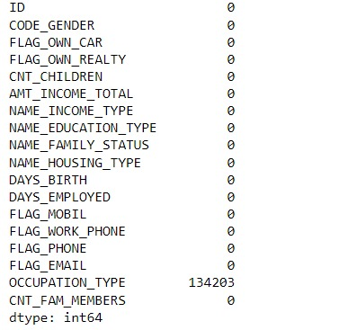
Exploratory Data Analysis (EDA)
Data preparation
Loading application dataset from file
and checking its shape.
Looking the application dataset to find out the applicants whose gender is Male and has his own car.
Checking the shape of application dataset and finding the sum of NA values.

Slide 7
Data cleaning
Since NA values are only present in OCCUPATION_TYPE , we fill the missing values by fillna() and value given as ‘Others’.
Looking for duplicate values in df_applications and found out 79.5% are duplicate values. So we dropped the duplicates value and got shape as
You can see that your dataset has many columns with values as 'Yes' or 'No’. But in order to fit a regression line, we would need numerical values and not string. Hence, we need to convert them to 1s and 0s, where 1 is a 'Yes' and 0 is a 'No'.

Slide 8
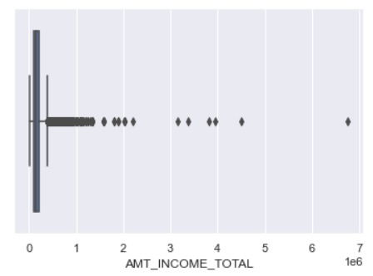
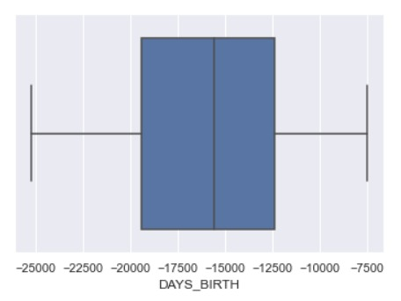
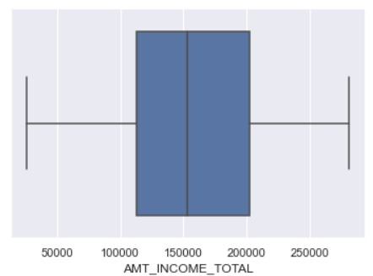
boxplot
Here Amt_income_total has outlier and we treated this with iqr outlier treatment method

Slide 9
Data cleaning
(438557, 18)
(90085, 16)

Slide 10
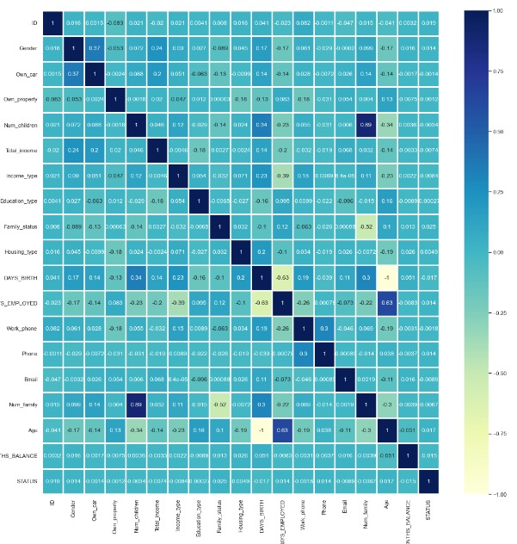
Data visualisation
Features does not shows much correlation.
So, let’s do individual features analysis to get some insight.

Slide 11
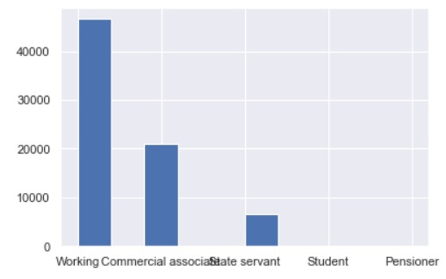
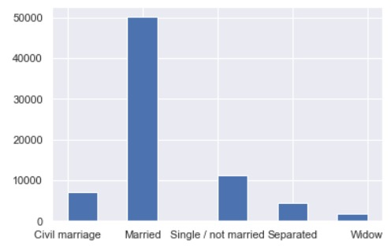
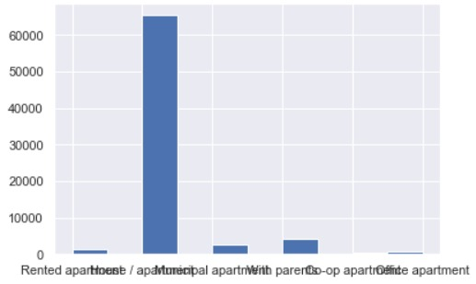
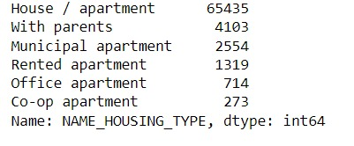
Fig 1 : Histogram plot for 'NAME_INCOME_TYPE’ fig 2 : Histogram plot for 'NAME_FAMILY_STATUS’ fig 3 : Histogram plot for 'NAME_HOUSING_TYPE'

Slide 12
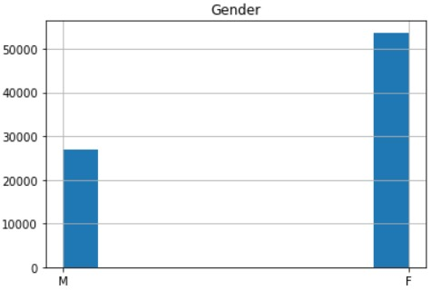
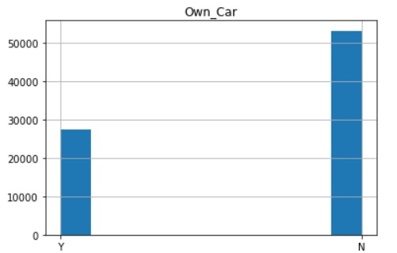
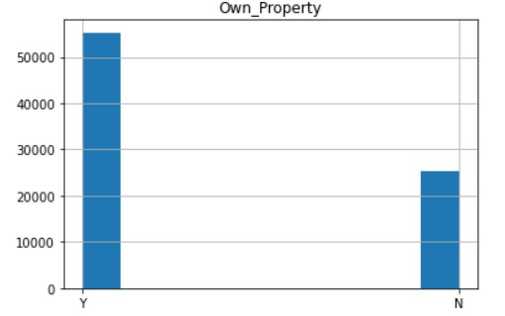

Slide 13
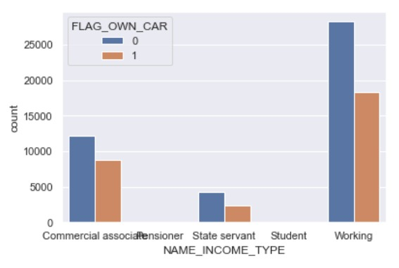
NAME_INCOME_TYPE VS FLAG_OWN_CAR

Slide 14
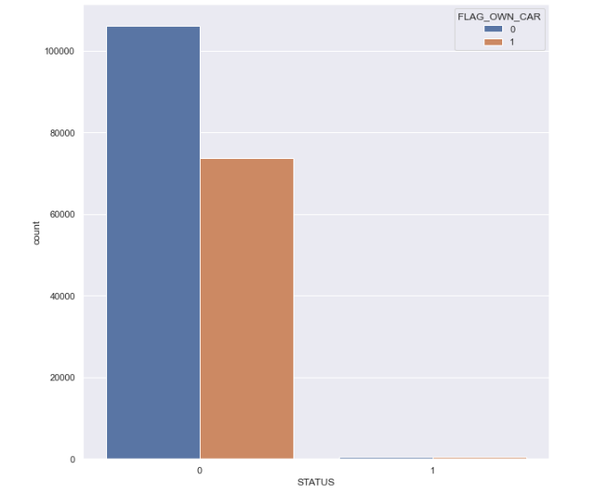
STATUS VS FLAG_OWN_CAR
Applicants without an own car are more than people with an own car.
So an applicant with or without car can’t decide the approval of Credit Card.

Slide 15
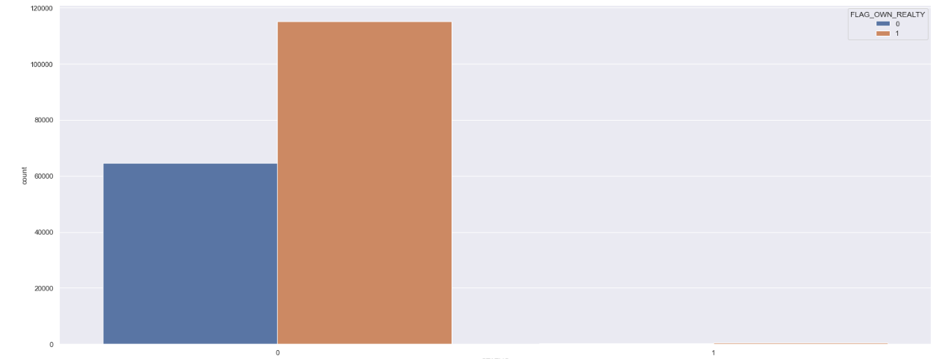
Status vs FLAG_own_property
Applicants with an own property gets an higher chance of credit card approval.

Slide 16
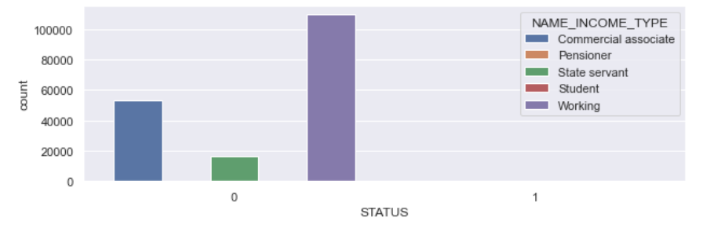
STATUS VS NAME_INCOME_TYPE
Name_Income_Type Working has a greater credit card approval status.

Slide 17
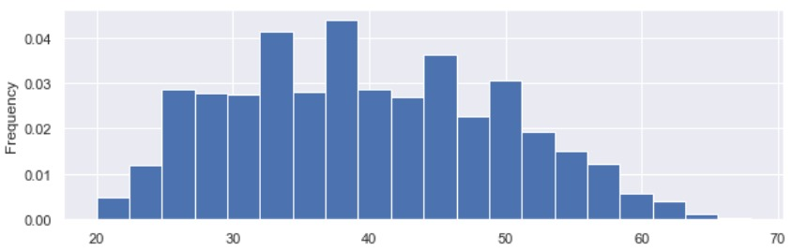
Frequency of age of applicants

Slide 18
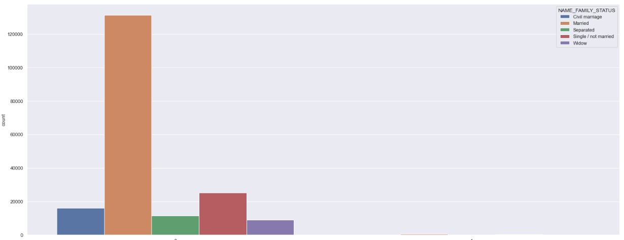
STATUS VS FAMILY_STATUS
Family_Status Married has a greater credit card approval status.

Slide 19
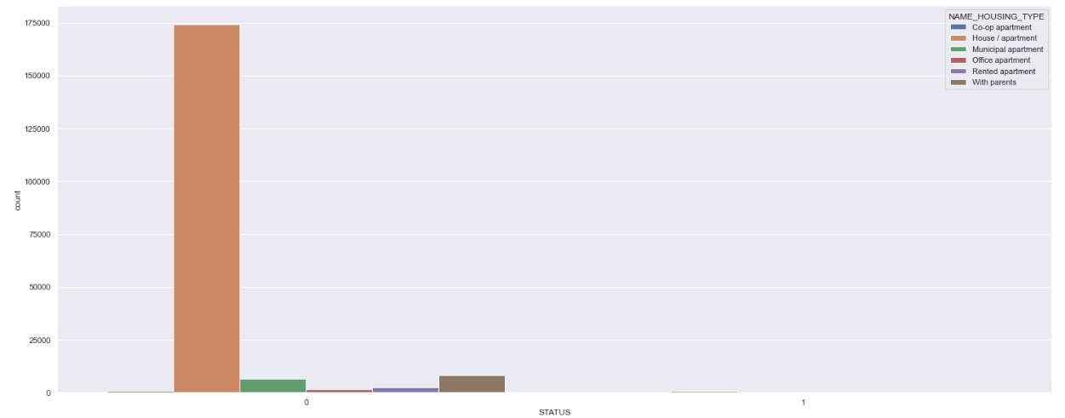
STATUS VS NAME_HOUSING_TYPE
Name_Housing_Type House/Apartments has a greater credit card approval status.

Slide 20
MODEL BUILDING
To predict Credit Card Status:
Good Customer : 0 and Bad Customer: 11
Binary Classification Problem
Dividing Dataset:
Training : Test :: 0.67 : 0.33

Slide 21
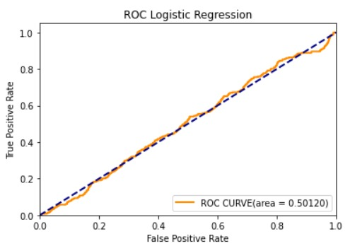
LOGISTIC REGRESSION
Library used : sklearn.linear_model (LogisticRegression)
Accuracy = 0.9956
Precision = 1.00
Recall = 1.00
F1-Score = 1.00
Actual value
TP
FP
63772
0
Predicted
275
0
FN
TN

Slide 22
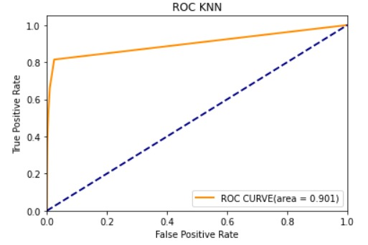
K NEAREST NEIGBOUR (KNN)
Library used : sklearn.neighbors (KNeighborsClassifier)
Accuracy = 0.996
Precision = 1.00
Recall = 1.00
F1-Score = 1.00

Slide 23

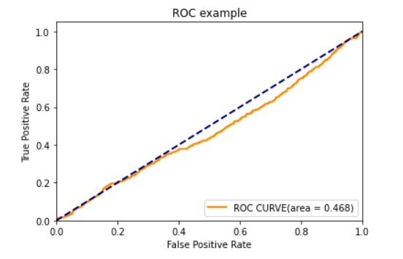
SUPPORT VECTOR MACHINE (SVM)
Library used : sklearn.svm (SVC)
Accuracy = 0.9951
Precision = 1.00
Recall = 1.00
F1-Score = 1.00

Slide 24
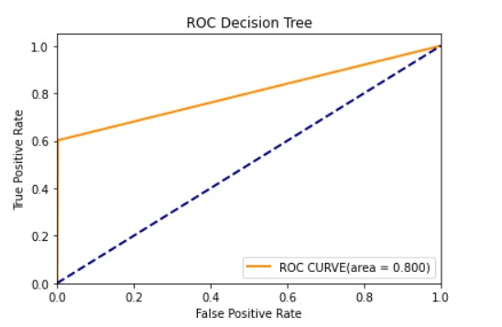
DECISION TREE
Library used : sklearn.tree (DecisionTreeClassifier)
Accuracy = 0.9963
Precision = 0.9981
Recall = 0.9982
F1-Score = 0.9982
Actual Value
TP
FP
63655
125
Predicted
110
157
FN
TN

Slide 25
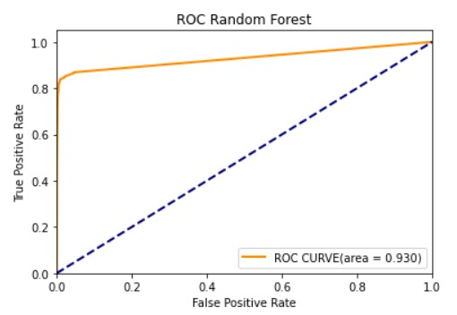
RANDOM FOREST
Library used : sklearn.ensemble (RandomForestClassifier)
Accuracy = 1.00
Precision = 1.00
Recall = 1.00
F1-Score = 1.00
Actual Value
TP
FP
63695
57
Predicted
141
154
FN
TN

Slide 26
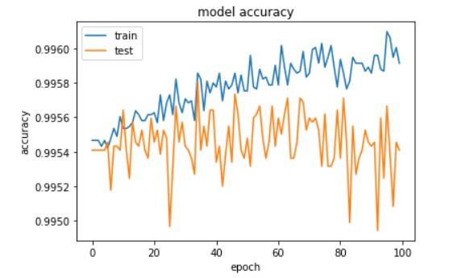

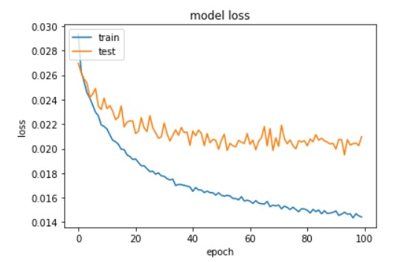
ARTIFICIAL NEURAL NETWORK (ANN)
Library used: Keras
Accuracy = 0.9958
Precision = 0.9965
Recall = 0.9993
F1-Score = 0.9979

Slide 27
COMPARING THE ML ALGORITHMS
 | ACCURACY | PRECISION | RECALL | ROC AUC VALUE
LOGISTIC REGRESSION | 99.56 | 100 | 100 | 50.12
KNN | 99.6 | 100 | 100 | 90.1
SVM | 99.51 | 100 | 100 | 46.8
DECISION TREE | 99.63 | 99.81 | 99.82 | 80.0
RANDOM FOREST | 100 | 100 | 100 | 93.0
ANN | 99.58 | 99.65 | 99.93 | --

Slide 28
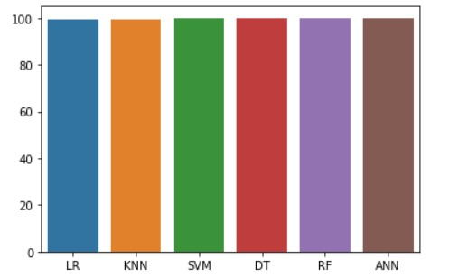
CONCLUSION
Hereby we conclude that Random Forest Approach is best algorithm of predicting the credit card sales with higher accuracy , recall value and ROC curve area .
We also found that in further we need to use this algorithm for the future and we will use for different datasets that is related to credit card sales.

Slide 29
THANK YOU

